Slide 1

CM515 Week 2
Introduction to Command Line
January 26, 2025
Notes:
Presentation created from “Introducing the Shell” website linked here: https://colorado-state-university-cmb.github.io/shell-novice/01-intro/index.html

Slide 2

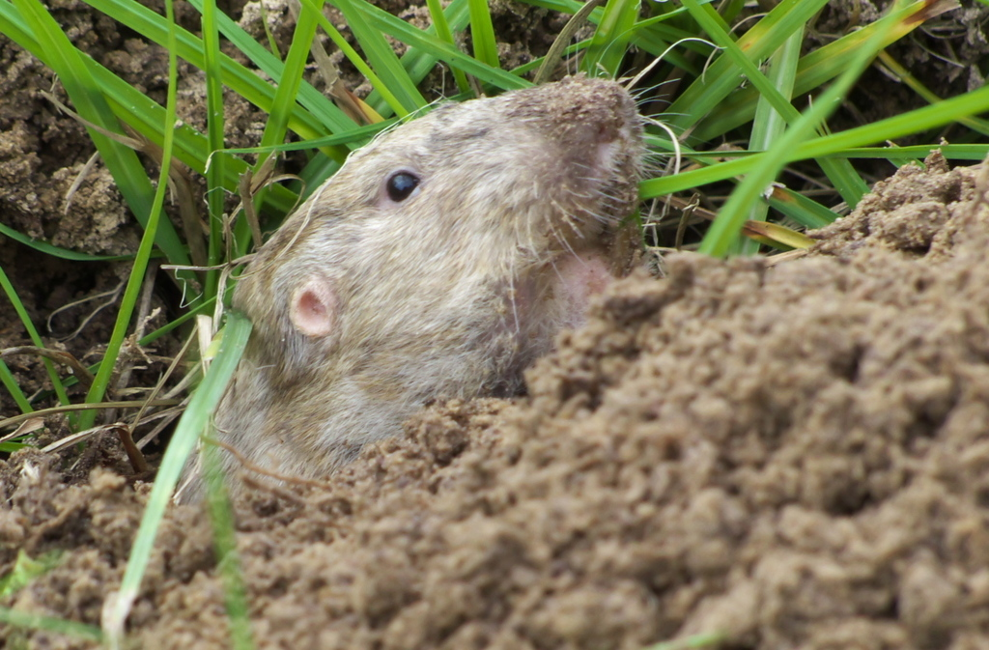
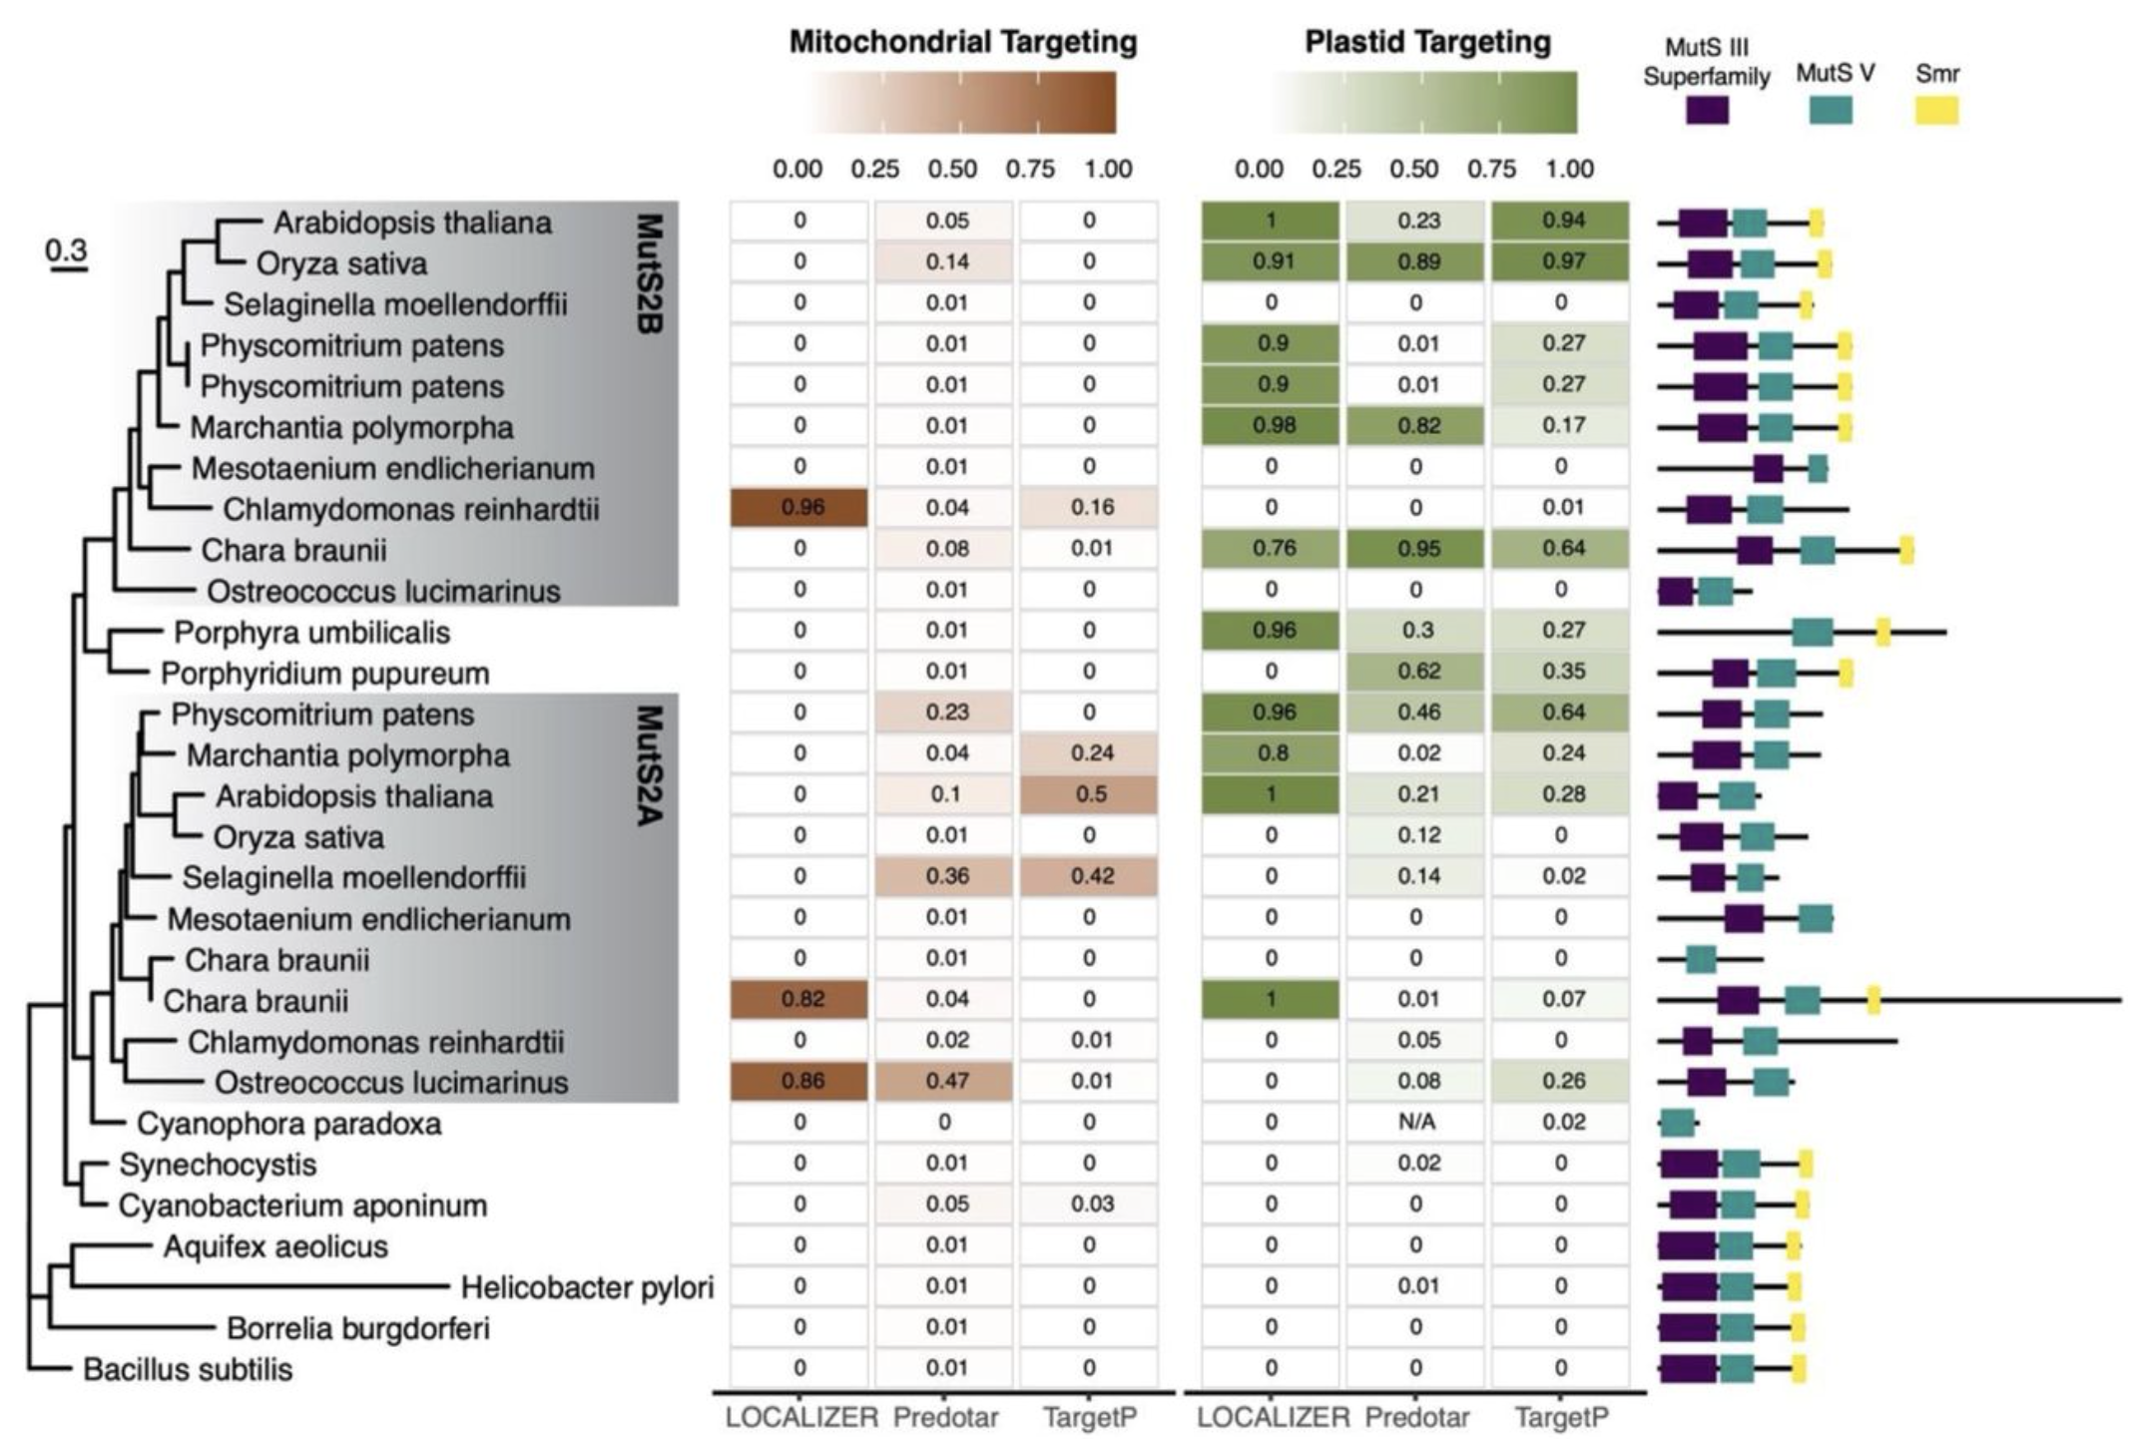
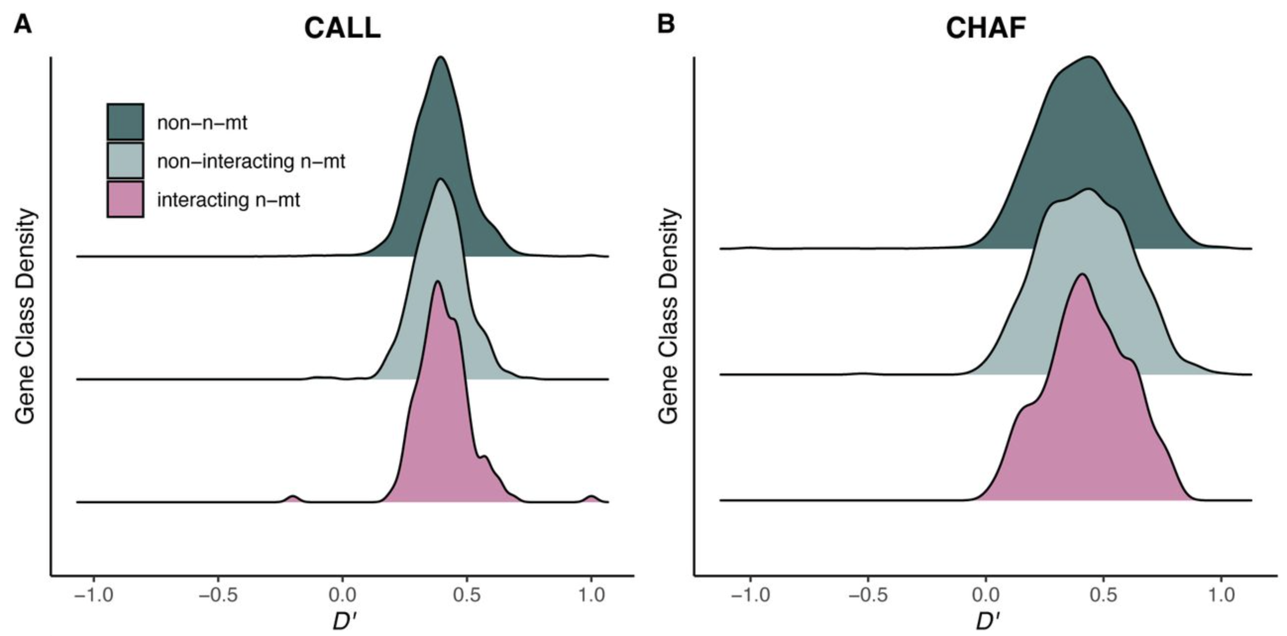
Shady’s story to computational biology
Undergrad:
genetics research required me to learn command line to assemble genomes
began taking computer science classes in undergrad
Computational research in the Sloan lab
Geomys breviceps

Slide 3
Agenda
Introductory lecture (~20 min)
Terminus Activity (~30 min, can make shorter/longer)
Command Line syntax (~10 min)
***10 MINUTE BREAK***
Useful commands (~15 min)
Try in Terminus/demo for the class
Practice Questions (~25 min)

Slide 4
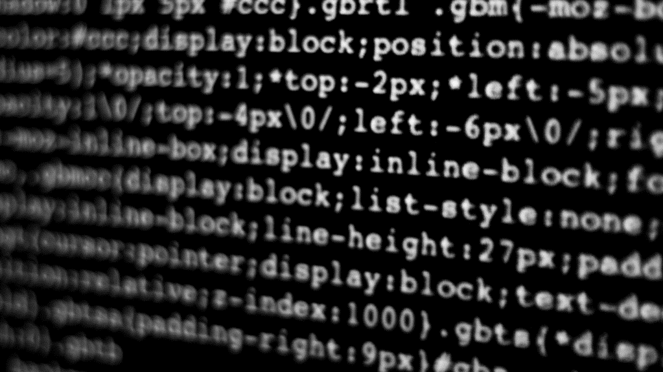
Introducing the Shell (and de-mystifying computer science jargon along the way)

Slide 5

I mean, you can use a GUI but it’s faster if you use the shell. Just open your terminal and run a BASH script.
Notes:
Don’t be intimidated when you hear things like this. Let’s define some computer science jargon!
Image: https://screenrant.com/matrix-code-inspiration/

Slide 6

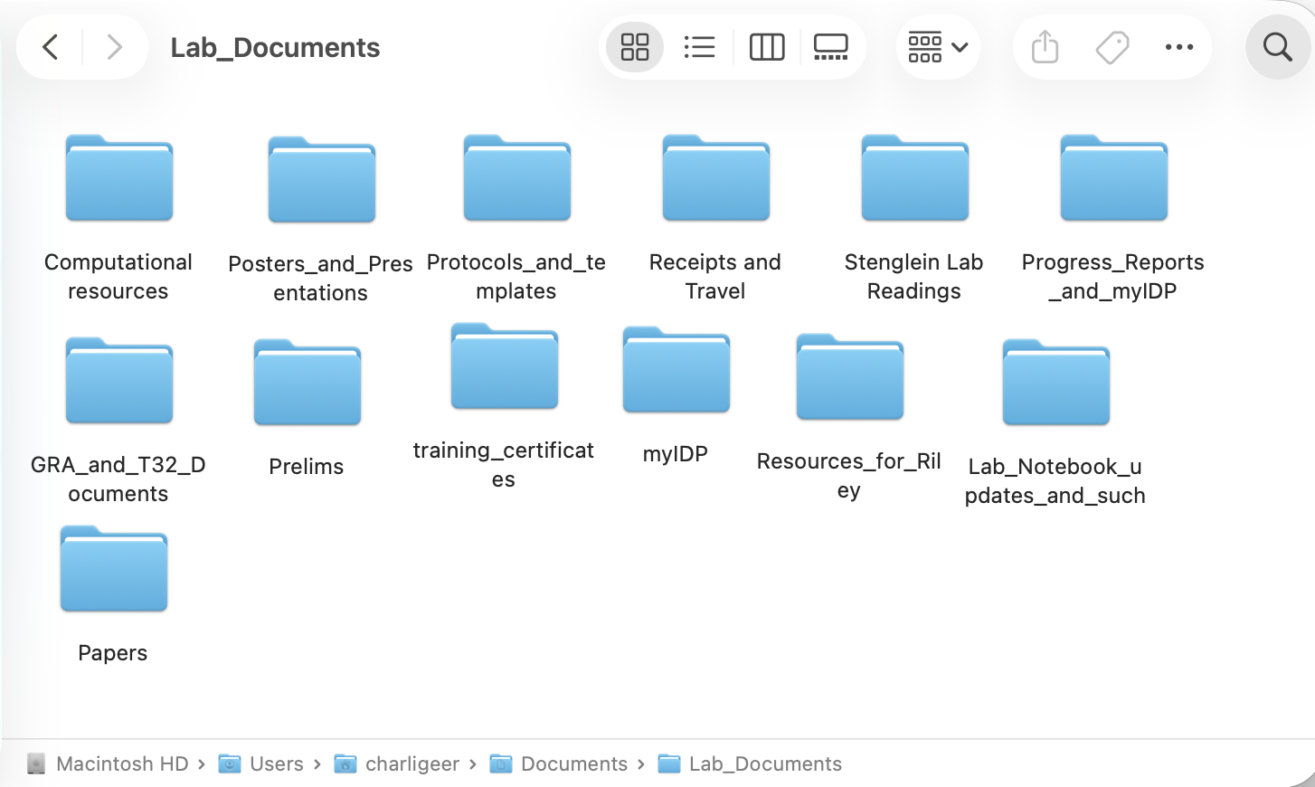

Graphical User Interface (GUI)
The average human interacts with a computer using a Graphical User Interface (GUI)
With a GUI, you give the computer instructions by clicking a mouse and using menu-driven interactions.
Navigating folders/directories to find files
Creating files
Editing file names
Etc!
Notes:
Image: https://www.istockphoto.com/photos/person-using-mouse

Slide 7
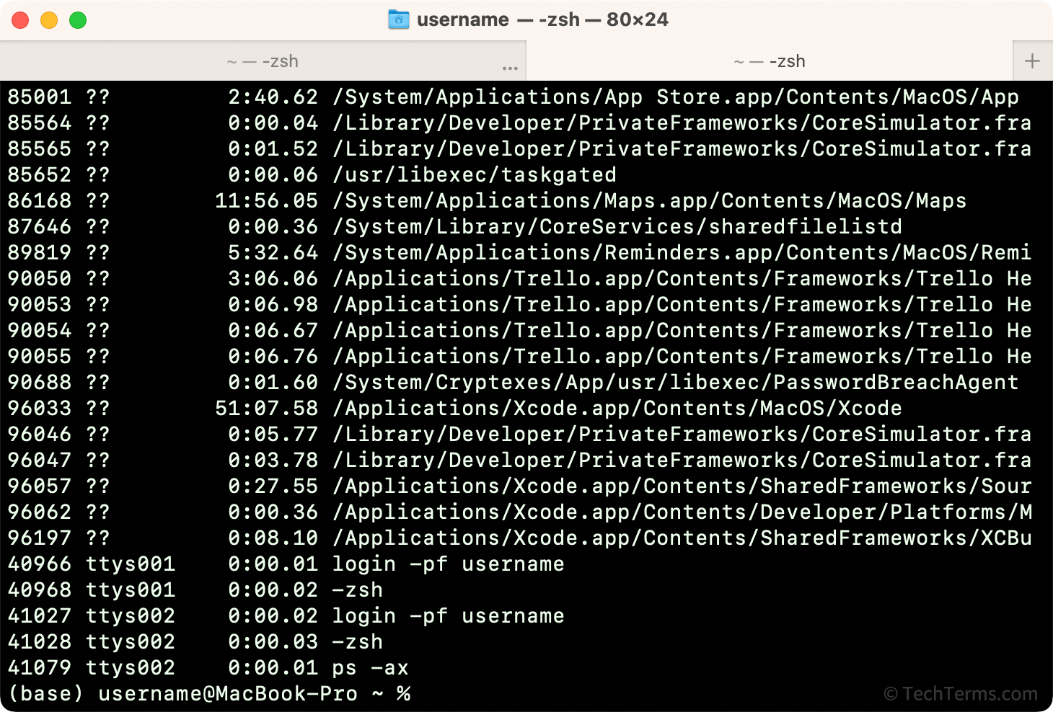

The Unix Shell
The shell is a program where the user (you!) can type commands that are carried out by the computer.
Uses a command-line interface (think typing, no mouse clicking)
Multiple commands can be written and carried out in a script
Scripts accomplish repetitive tasks
The most popular unix shell is called Bash
Notes:
Image: https://en.wikipedia.org/wiki/Typing

Slide 8



Bash (the most popular Unix Shell)
Bash is a shell: a command-line interpreter and scripting language
(you give commands, the Bash shell puts them into action!)
Bash acts as a bridge between you and your computer’s operating system.
Fun fact: The name bash is short for “Bourne Again SHell” (it is derived from a shell written by Stephen Bourne in the 1970s)
beep boop
beep boop
Clickity
clackity
Notes:
Images:
https://www.vectorstock.com/royalty-free-vectors/bridge-cartoon-vectors
https://www.istockphoto.com/illustrations/operating-system
https://www.vecteezy.com/vector-art/67549027-black-and-white-illustration-of-a-man-focused-on-typing-on-a-computer-keyboard
Bourne again shell: https://en.wikipedia.org/wiki/Bourne_shell

Slide 9
The shell (aka Bash)
GUI
Notes:
Review the big picture: remember that both the GUI and the shell can accomplish some of the same tasks, like making files/directories and navigating your computer's file system.
Images:
https://en.wikipedia.org/wiki/Typing
Bourne again shell: https://en.wikipedia.org/wiki/Bourne_shell

Slide 10

This is all great.
But why can’t I just use a GUI?
It works well, and I’m good at it!
Notes:
You might be thinking: “This is great, Charli, but why can’t I just use a GUI? It works well for me, and I’m good at it!”
You are all budding computational biologists! The Shell is an essential skill for working with big data.
It is not easy to learn, it will take effort, but you can do it! And believe me, it will be worth it!
Image: https://stock.adobe.com/search?k=old+person+using+computer

Slide 11

Why do computation biologists use the UNIX shell, command line, and BASH scripts?
Fast and automated
Very reproducible
Great for repetitive tasks
(things that would take humans an ungodly amount of time)
Remote access to supercomputers
(Aka computers that are wayyyyyyyy more powerful than your laptop)
Notes:
Start by asking the class if they have ideas. If they are quiet and tired, just go through it instead.

Slide 12

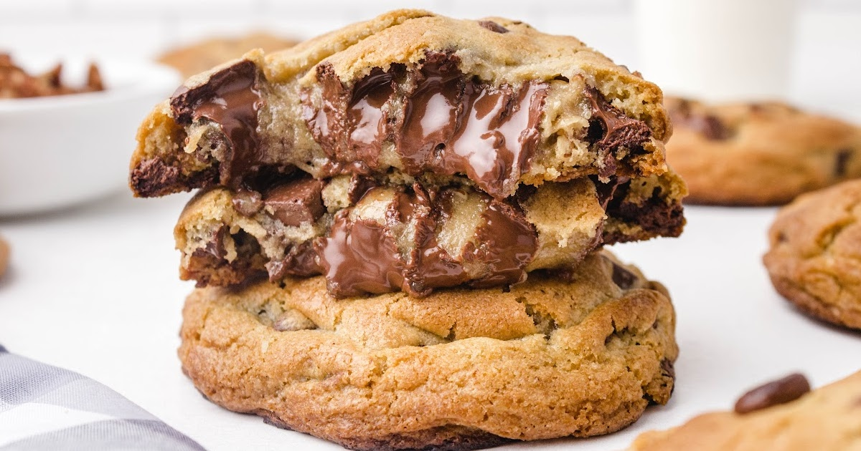
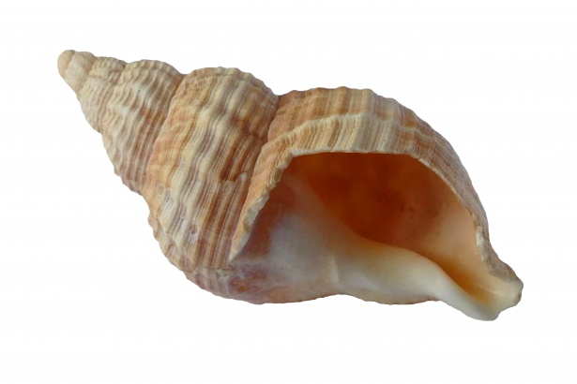
RAPID REVIEW
Define the following with the person next to you:
GUI
Directory
Command line
Script
The Unix Shell
Bash
Notes:
Images:
https://wikirby.com/wiki/Gooey\
https://thebestblogrecipes.com/ooey-gooey-cookies/
https://www.publicdomainpictures.net/en/view-image.php?image=228414&picture=sea-shell

Slide 13
Learning commands
Learning commands is like learning a new language: it takes effort! You must learn proper syntax (grammar) and new words (commands)
Unlike a GUI, the command line interface doesn’t automatically present choices to you. However, a small number of key commands can take you a long way!
Notes:
Rather than tell you the commands, let’s discover them…

Slide 14
Terminus Activity! (20 min)
Go to any internet browser and look up: “Terminus MIT”. Click the first link.
Go forth and explore the world of terminus. Feel free to talk and discuss your findings!
Tips:
Pay attention to spelling/capitalization
Use “tab” to autocomplete names/locations
Use the ” ↑ ” key to view/repeat previous commands
Notes:
If folks are having fun and learning, feel free to do 30 min and take a break afterward.
Have them raise hands if they get stuck, confused, or frustrated.

Slide 15
10 minute break
Notes:
Write on board:
Locations = directories
Items = files
Location where you currently exist = current working directory

Slide 16
Command line syntax
What did you learn from playing Terminus?
Notes:
Ask the class about the "grammar" of the game. Make connections between the game and real computers. Write on board:
Locations = directories
Items = files
Location where you currently exist = current working directory

Slide 17
Command line syntax
No spaces in the names of files or directories
Capitalization/spelling must be exact
Press “enter” to execute commands
Prompt: symbol showing that the shell is ready for input.
In terminus: >
Can also be: % or $
Flashing text cursor, waiting for input.
Note: Terminus is a game where pictures and visuals appear. Command line (the shell) does not have visuals.

Slide 18
Important Commands

Slide 19
Basic Commands
Command
Purpose
ls
List directories and files
pwd
Print working directory (where are you?)
cd
Change directory
less
View content of a text file
man
Show the manual for a linux command
touch
Create file
mkdir
Create directory
rm
Deletes a file
Notes:
Describe the purpose of each command. Ask students what command from terminus matches, one at a time. Can give hints (“this one moved you between locations in Terminus…”)
They should know the first 4. It’s okay if they didn’t get far enough in the game to learn the last four commands.
Feel free to demo in your terminal if students want to see what it really looks like.

Slide 20
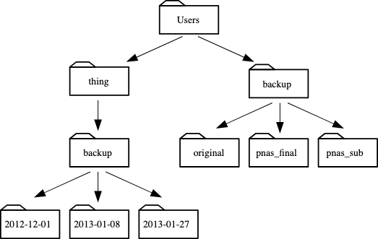
Using cd (moving around)
What does each command do? If you are unsure, try it in Terminus!
cd
cd ..
cd ~
cd .
Answers:
. = current working directory
.. = parent directory of your current directory
~ = home directory
You are here!
Notes:
Ask students to take two minute and talk with the person next to them.
Then give the answers and point out the working directory, parent directory, and home directory in the image.

Slide 21
Using cd (moving around)
You can use a file path to move quickly from your home directory to other directories.
Example:
cd thing
cd backup
cd 2012-12-01
OR
cd thing/backup/2012-12-01
Notes:
Ask students to take two minute and talk with the person next to them.
Then give the answers and point out the working directory, parent directory, and home directory in the image.

Slide 22
Practice Questions
Think about the following questions and/or discuss with the person next to you.
1) When you first open the shell (aka terminal), why do you start with pwd or ls as a first command?
2) Isabelle is working on her thesis. She writes it all in a text document called “thesis.txt”. She is practicing Bash commands and wants to make a copy of her thesis. She makes sure she is in the correct directory, and then she does the following:
less thesis.txt → the output displays her whole thesis
touch thesis.txt → nothing appears to happen in the directory. It still contains one file: “thesis.txt” that is unchanged.
Why didn’t “touch” make a new file? Is there a command that copies files? (hint: it’s not in Terminus…)
3) Tom is also working on his thesis. He made two copies of his thesis called “thesis1.txt” and ”thesis2.txt”. Normally, he deletes files by moving them to the trash on his desktop (aka using a GUI). This time, he uses command line to delete the 2nd copy: “rm thesis2.txt”
Tom’s advisor suddenly asks to see “thesis2.txt”. Tom looks in the Trash folder on his desktop, but it’s not there! What happened?
Notes:
Ask students to take five minutes to talk to the person next to them. Then take five minutes to go over and answer questions. You can also demo on your terminal.
Emphasize caution with the rm command. Note that touch doesn’t overwrite files, but other commands will! Such as cp and mv

Slide 23
Questions?
Notes:
Next week we will do an example and see these commands in action!

